Slide 1





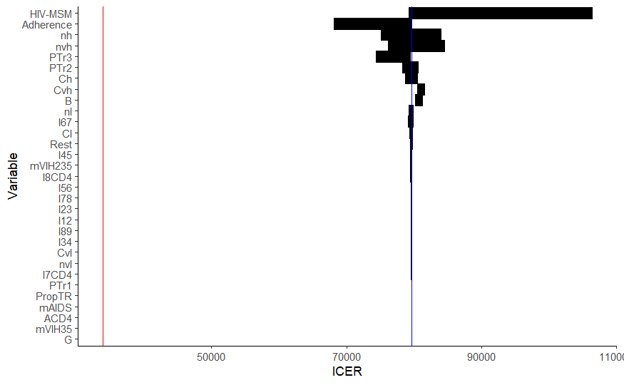
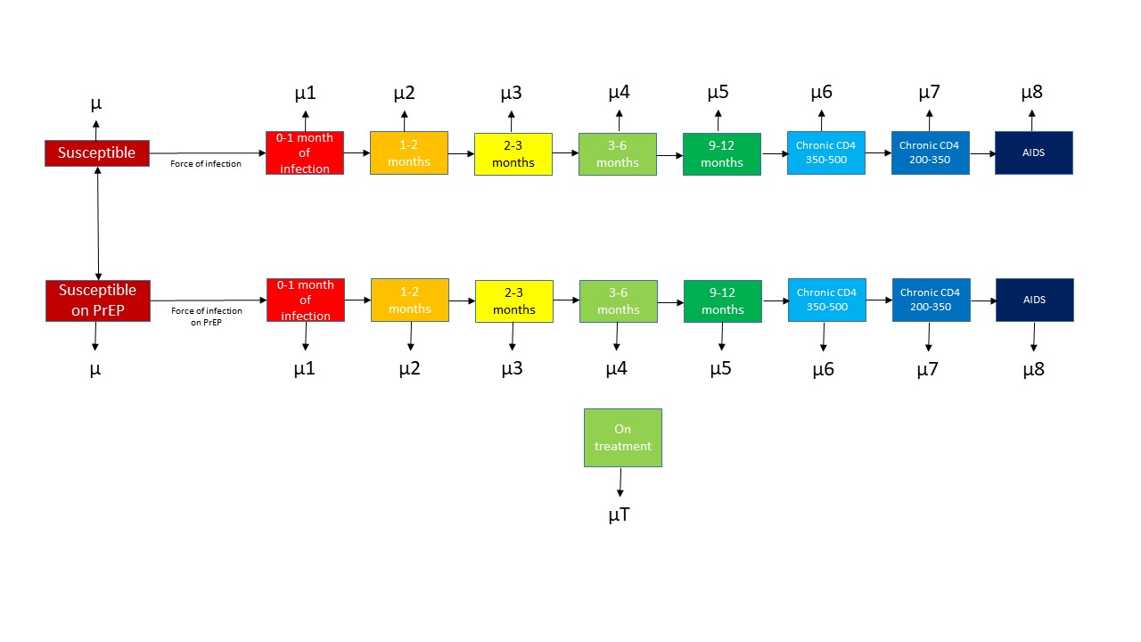
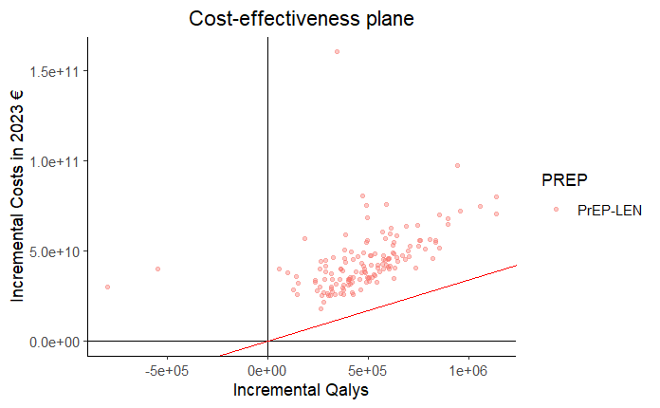
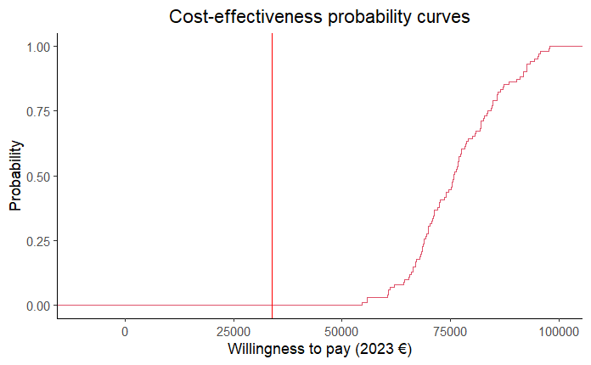
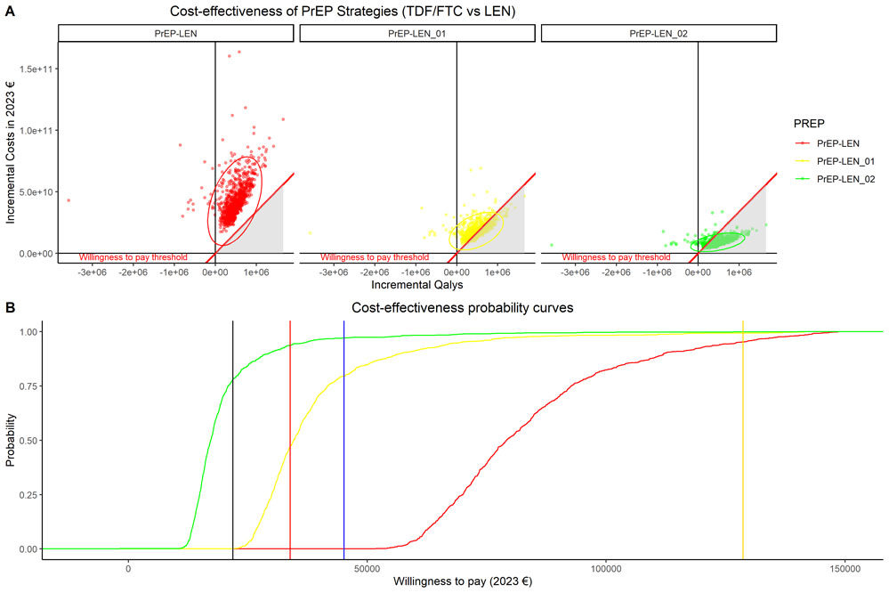
Cost-effectiveness of lenacapavir versus tenofovir disoproxil fumarate plus emtricitabine for pre-exposure prophylaxis to prevent HIV-1 transmission in gay, bisexual and other men who have sex with men in a European country.
Abstract Code: MeP16.3
P. Wikman-Jorgensen¹ , C. Iniesta^{2,3} , M. Ruiz-Algueró⁴ , F. Pulido^{3,5,6} , J.A. Perez-Molina^{3,7} , J. Llenas-García⁸.
1. Hospital Clínico San Carlos, Infectious Diseases, Madrid, Spain. 2. Spanish Interdisciplinary AIDS Society (SEISIDA)., Madrid, Spain, 3. Instituto de Salud Carlos III, CIBER de Enfermedades Infecciosas (CIBERINFEC), Madrid, Spain, 4. University of British Columbia, Faculty of Medicine, Vancouver, Canada, 5. Institute for Healthcare Research Hospital 12 de Octubre (imas12), 6. Universidad Complutense de Madrid, HIV Unit, Madrid, Spain. 7. University Hospital Ramon y Cajal, Referral Centre for Tropical Diseases. Infectious Diseases Department., Madrid, Spain. 8. National Referral Centre for Imported Diseases and International Health, Hospital Universitario La Paz, IdiPAZ, Madrid, Spain.
PURPOSE
RESULTS
Table 2. Costs of patients on PrEP and costs of patients on ART used for the PrEP cost-effectiveness calculation.
Lenacapavir (LEN) has proven to be superior to current recommended regimen, tenofovir disoproxil fumarate plus emtricitabine (TDx/FTC), as pre-exposure prophylaxis (PrEP) for key populations at high risk of HIV acquisition.¹ However, to date no studies have evaluated the cost-effectiveness of this strategy at a national level. This study aims to compare the cost-effectiveness of currently approved daily PrEP in Spain, with TDx/FTC, in gay, bisexual and other men who have sex with men (GBMSM) versus the newer alternative with subcutaneous LEN every 6 months.
Item | Unit cost (2023€) | Annual units | Weekly cost (2023 €) | Source
Patients on PrEP
TDx/FTC | 0.97 | 365 | 6.8 | Spanish retail price
LEN | 16.76 | 365 | 834.29 | Spanish retail price
Nurse administration (only LEN arm) | 27 | 2 | 3.11 | The cost of each unit of resource has been estimated as the average of the public prices (to be applied by health centers to third parties obliged to pay or to users without the right to health care corresponding to the health services provided by the health services of the different autonomous communities)
HIV specialist 1st visit | 148.78 | 1 | 2.86
HIV specialist 2nd visit | 92.92 | 1 | 1.78
HIV serology | 13.53 | 4 | 6.99
Syphilis reaginic test | 7.30 | 4 | 0.56
TPHA test | 17.67 | 4 | 1.35
Hemogram | 4.34 | 4 | 0.33
Na and K+ | 3.06 | 4 | 0.23
Creatinine | 0.75 | 4 | 0.05
Glycemia | 0.71 | 4 | 0.05
Phosphorus | 0.71 | 4 | 0.05
Transaminases | 3.92 | 4 | 0.30
Urine sediment | 4.31 | 4 | 0.33
PCR for Chlamydia and Gonococcus | 85.38 | 4 | 6.56 | Lopez-Seguí et al. PLoS One 2023.
Total TDx/FTC |  |  | 20.99
Total LEN |  |  | 834.29
Patients on ART
ART | 23.56 | 365 | 165.38 | The cost of each unit of resource has been estimated as the average of the public prices (to be applied by health centers to third parties obliged to pay or to users without the right to health care corresponding to the health services provided by the health services of the different Autonomous Communities)
Test for resistances | 328 | 1 | 6.30
Viral load | 96.81 | 2 | 3.72
CD4 count | 25.17 | 2 | 0.96
Consultation | 427.54 | 1 | 8.22
HLA-B5701 | 151 | Once in life | 2.90
Hemogram | 4.34 | 2 | 0.33
Na and K+ | 3.06 | 2 | 0.23
Creatinine | 0.75 | 2 | 0.05
Glycemia | 0.71 | 2 | 0.05
Phosphorus | 0.71 | 2 | 0.05
Transaminases | 3.92 | 2 | 0.30
Total |  |  | 188.54
Model parameters and costs
Fig. 1 shows the model; table 1, the model parameters and transition probabilities; and table 2, the costs. The model was adjusted to fit AIDS mortality and new AIDS cases.
Figure 2. Tornado plot of the one‑way sensitivity analysis for the incremental cost‑effectiveness ratio (ICER) of LEN versus daily TDx/FTC. The vertical red line represents the willingness-to pay-threshold. Bars show the change in the ICER (x‑axis) when each input parameter (y‑axis, ranked by influence) is varied across its plausible range while all others are held at base‑case values. The vertical blue line marks the base‑case ICER; the red line indicates the willingness‑to‑pay threshold (€ 33,895 per quality‑adjusted life‑year [QALY]). Parameters whose bars extend furthest from the blue line exert the greatest impact on cost‑effectiveness—most notably number of GBMSM living with HIV (HIV‑MSM), PrEP adherence, and the annual number of high‑risk partners (nh). None of the tested ranges drive the ICER below the threshold, indicating that LEN remains more costly per QALY gained than TDF/FTC under all plausible one‑way variations.
METHODS
Target population, setting and interventions
The target population were GBMSM 16 years or older receiving care in the Spanish National Healthcare System. Baseline scenario was 2023 with a PrEP program in place consisting in daily TDF/FTC. We evaluated the implementation LEN injected subcutaneously every 6 months. In each case, we considered that patients underwent regular follow-ups, as per the Spanish Infectious Diseases Society guidelines.²
Model development
A stochastic, dynamic, transmission Markov chain model was developed and calibrated to replicate the results of the HIV epidemic in Spain in accordance with a previous study.³ The model (Fig. 1) represents the current estimated population of GBMSM. Probabilities of transitioning from one state to another are governed by the parameters presented in table 1. The model was stratified by age group and by sexual activity risk groups. A time horizon of 20 years was chosen. Model parameters were obtained from published studies, systematic reviews and meta-analyses, and expert consultation. For calibration, the model parameters were given a probability distribution, and the model was run 100,000 times. The set of parameters with the best fit was the final set of parameters used. Analyses were undertaken using R.
Cost evaluation and Health outcomes
We used a healthcare provider perspective. Costs are presented as 2023 euros (2023€) and were calculated with the model, depending on the population in each state at each time point. The model was used to obtain calculated quality-adjusted life years (QALYs) for each scenario.
Cost-effectiveness evaluation
We ranked interventions by effectiveness and then calculated incremental cost-effectiveness ratios (ICER) by comparing LEN to TDx/FTC. Effectiveness and costs were subject to an annual discount measure of 3%. The willingness-to-pay (WTP) threshold used was the per capita gross domestic product of Spain in 2023 (2023 €33,895).
Sensitivity analysis
A one-way sensitivity analysis and a probabilistic sensitivity analysis (PSA) were undertaken.
Figure 1. A Markov chain model for the transmission of HIV and the influence of pre-exposure prophylaxis (PrEP). µ: mortality. Starting at the upper left corner, the “susceptible state” represents non-HIV infected GBMSM at risk for HIV acquisition. People in this state may acquire HIV and transition into the first of the 8 states that represent the history of HIV natural infection, in accordance with previously used models.²³ At any point in those 8 states, the patient may be diagnosed and started on ART. The susceptible persons may start on PrEP, where the risk of infection is much lower, but still possible, and transition through the HIV infection stages, and at any stage they may be started on treatment. In each state the person has a mortality rate µ.
Table 1. Key parameters of the model. These parameters govern the initial population of the different model states and the probabilities of transition between each state.
The TDx/FTC arm yielded 8,546,030QALYs and cost €8,457,028,025 for the next 20 years. If LEN was used instead of TDx/FTC, it would cost
€47,062,063,906 (increase of €38,605,035,881) producing 9,030,933QALYs (Increase of 484,903.7QALYs), yielding an ICER of 79,613.82€/QALYs (table 3).
Parameter | CEA Value | Initial distribution | Source | PSA distribution
Number of GBMSM living with HIV | 33558 | Normal (33558,4000) | Hospital survey 2018 | Normal (32898,1000)
Baseline proportion of infected people on treatment | 0.89 | Beta (0.89,0.1) | Hernando et al.2023 | Beta (0.96,0.1)
% GBMSM that go off PrEP | 11.56% annually | NA | Aparicio et al.2019 | NA
% GBMSM that start PrEP | 30% annually | NA | Nichols et al. NEJM 2016 | NA
Mortality of PLWHIV | >350 200-350 <200 | Beta (0.0000538, 0.000048) Beta (0.00012692, 0.000061) Beta (0.04/52, 0.04/52) | Alejos et al. 2016 Kasaie et al. 2018 | Normal (8.18e-06, 1.63e-06) Normal (0.000148, 2.95e-05) Normal (6.41e-05, 1.28e-05)
Partner change rate in very high-risk compartment | 52.5/year | Gamma (52.5/52, 52.5/52) | Nichols et al. NEJM 2016 | Normal (2.75, 0.55)
Partner change rate high-risk compartment | 9/year | Gamma (9/52, 9/52) | Nichols et al. NEJM 2016 | Normal (0.036 , 0.007)
PrEP effectiveness | TDx/FTC 86% risk reduction LEN 96% risk reduction |  | PROUD 2016 PURPOSE2 2024 | NA
Figure 3. A) Probabilistic sensitivity analysis presented in the cost-effectiveness plane (red line represents willingness to pay threshold). B) Cost-effectiveness probability curves (red vertical line represents willingness to pay threshold).
Table 3. Results of the cost-effectiveness analysis. ICER: Incremental cost-effectiveness ratio. This quantity is calculated as the difference between the intervention and the less effective alternative.
Strategy | QALYs | Costs (2023€) | Incremental QALYs | Incremental Costs (2023€) | ICER incremental costs 2023€/ incremental QALYs
TDx/FTC | 8,546,030 | 8,457,028,025 | Baseline | Baseline | Baseline
LEN | 9,030,933 | 47,062,063,906 | 484,903.7 | 38,605,035,881 | 79,613.82
Adherence and number of GBMSM living with HIV were the main variables affecting the ICER in a deterministic sensitivity analysis (Fig. 2). However, it did not come close to WTP. A probabilistic sensitivity analysis was also undertaken (Fig. 3) where the cost was iterated down to €4,320 per six-month dose yielding a probability of cost-effectiveness of 93.6%(Fig. 4).
Figure 4. Cost‑effectiveness acceptability curves with country GDP reference thresholds (2023 €). The sigmoidal curves show the probability that the intervention is cost‑effective at each willingness‑to‑pay (€/QALY) threshold on the x‑axis. Drug‑cost scenarios evaluated are: €21 088.5 (red), €8 880 (yellow) and €4 320 (green). Vertical lines mark the 2023 per‑capita GDP thresholds often used as willingness‑to‑pay yardsticks: Croatia (black), Spain (red), Euro‑zone average (blue) and Luxembourg (yellow). Higher curves at a given x‑value indicate a greater likelihood that the intervention is cost‑effective under that cost scenario.
REFERENCES
CONTACT INFORMATION
CONCLUSIONS
Kelley CF, Acevedo-Quiñones M, Agwu AL, et al. Twice-Yearly Lenacapavir for HIV Prevention in Men and Gender-Diverse Persons. N Engl J Med 2024; published online Nov 27. DOI:10.1056/NEJMOA2411858.
GESIDA. Recomendaciones sobre la Profilaxis Pre-Exposición para la Prevención de la Infección por VIH en España. 2023; : 1–67.
Wikman-Jorgensen PE, Ruiz-Algueró M, Iniesta C, Pulido F, Llenas-García J. Cost-effectiveness of cabotegravir versus tenofovir alafenamide plus emtricitabine versus tenofovir disoproxil fumarate plus emtricitabine for pre-exposure prophylaxis to prevent HIV-1 transmission in gay, bisexual and other men that have sex with men. Enferm Infecc Microbiol Clin (Engl Ed). 2025 Aug-Sep;43(7):416-425. doi: 10.1016/j.eimce.2024.12.014. Epub 2025 May 22. PMID: 40410032.
LEN could be cost-effective in Spain at a price of €4,320 per six-month dose.
wikman.philip@gmail.com

